Slide 1
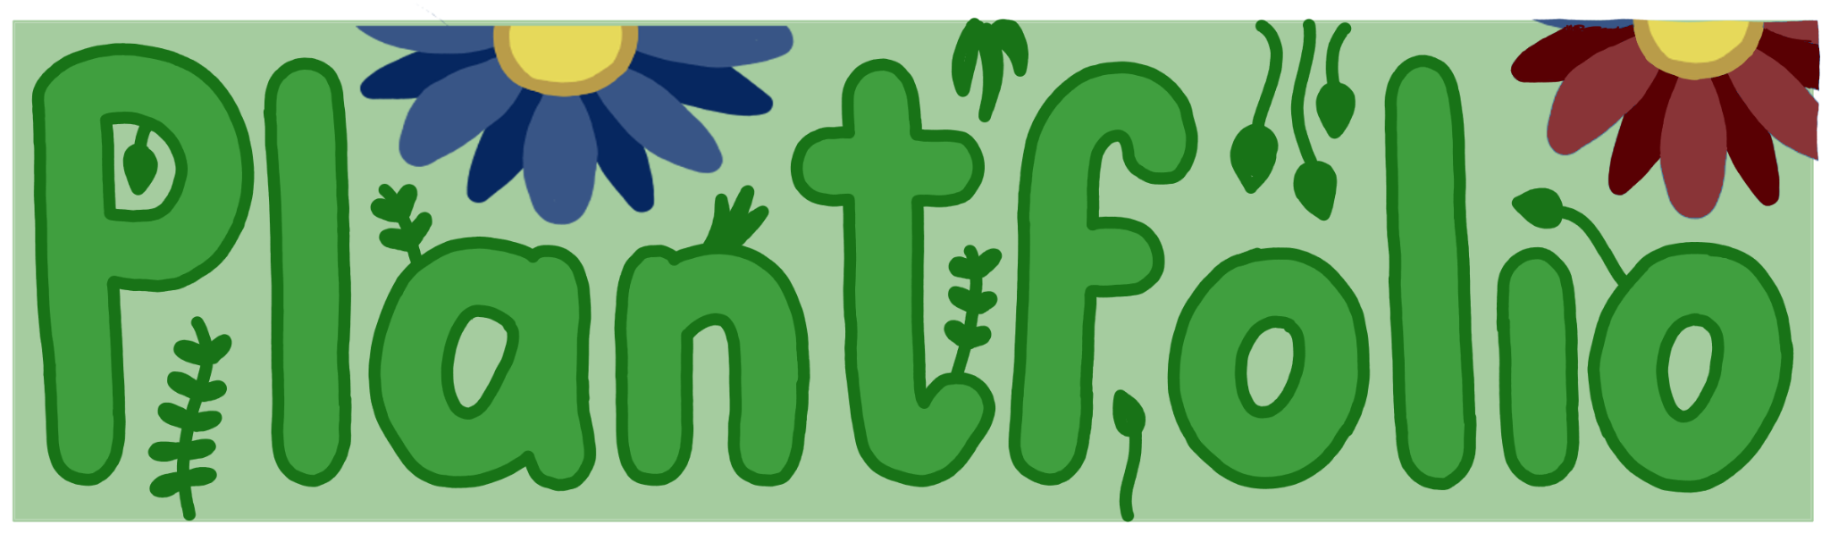
Group 10

Slide 2
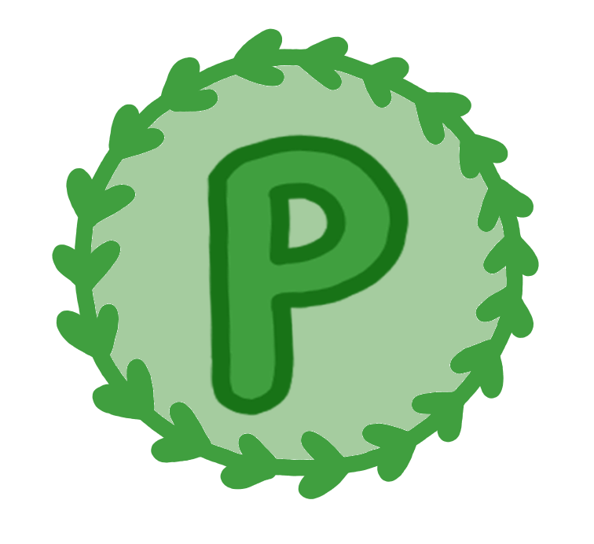
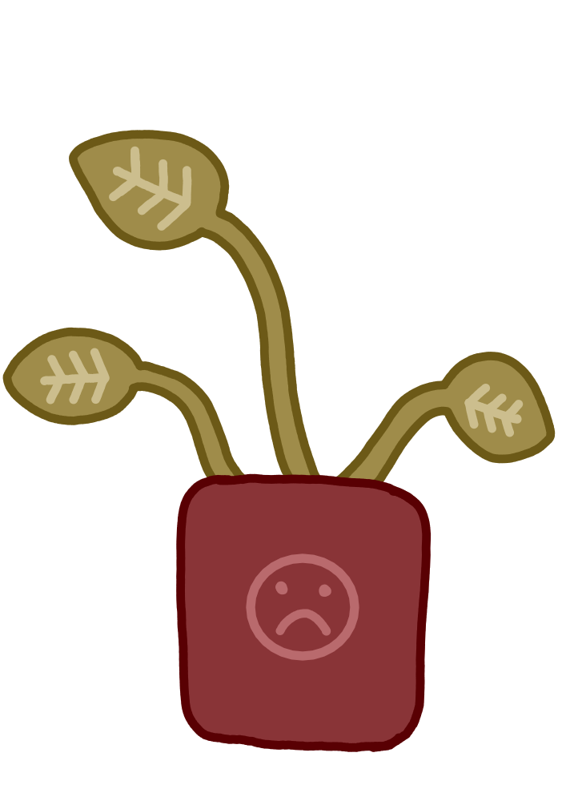
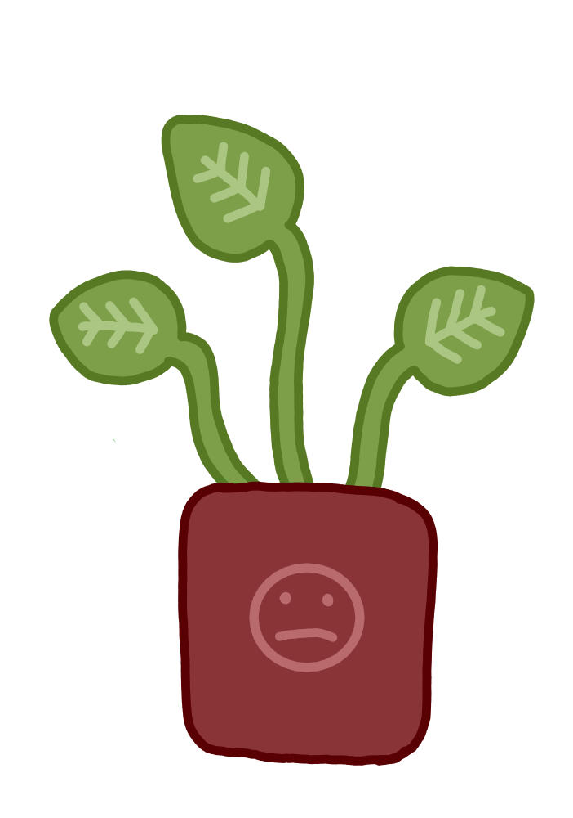
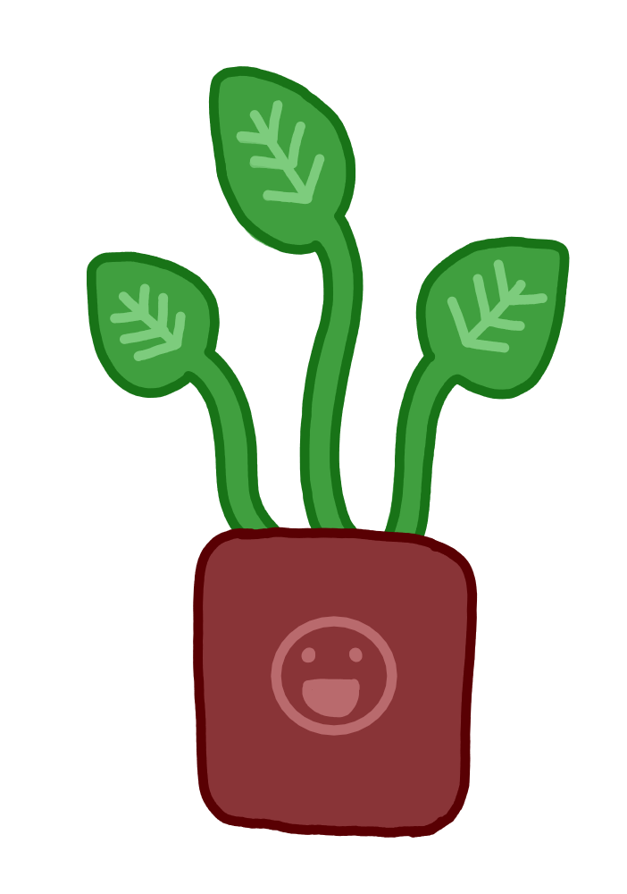
Progress so far
Goal of application: Help people care for their plants
Basic functionality: Display plant information
Track health based on light, water and nutrition
Suggest new plants to user

Slide 3
All requirements: Must-haves
1. Add rooms Done
2. Add spots Done
3. Import plant Done
4. Delete plant Done
5. Track attributes Done
6. Have database Done
7. Alert user In Progress
8. Suggest plants In Progress
9. Choose name and icon Done
10. Suggest other actions In Progress
11. Sort plants Done
We do still need a lot of tests

Slide 4
Demo Plantfolio

Slide 5
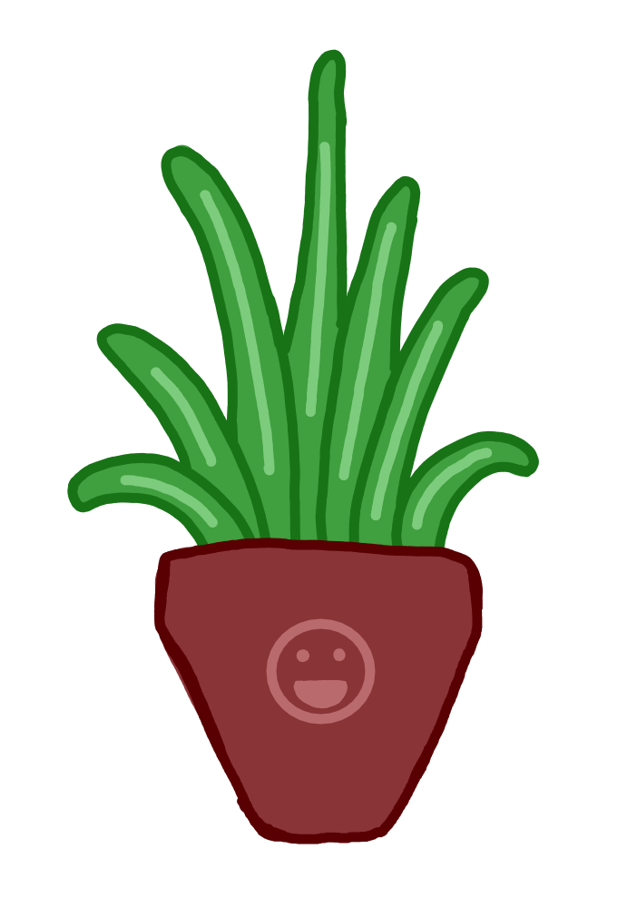
Reflection - what went well
Git issues
Issue structure → Labeling
Prioritisation → must-haves mostly done
Pair programming for difficult tasks

Slide 6
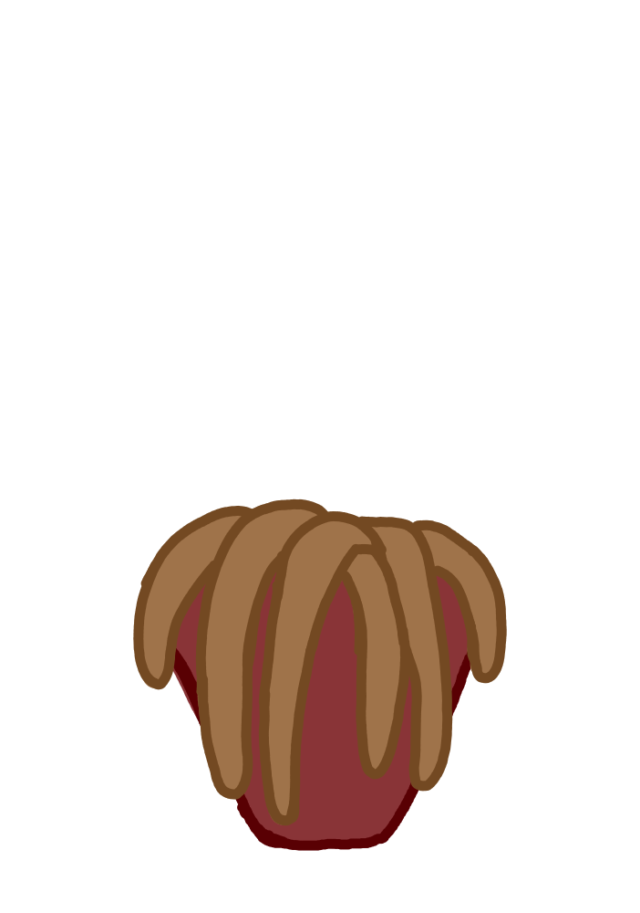
Reflection - what can improve
Working with 5 at a time is difficult
→ Split each UI window in separate file
Denzel’s late night coding sprees (division of labour)
→ Lock him out during Christmas Holidays and catch up
Underestimated the extent of the GUI

Slide 7

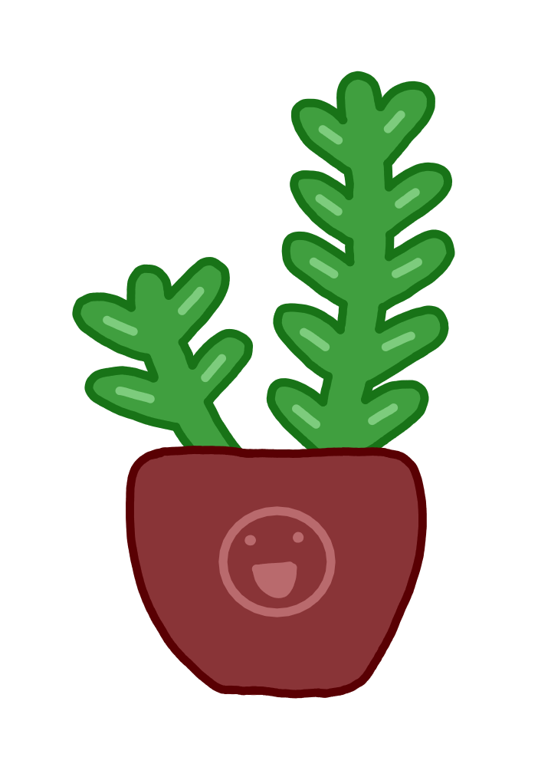
Planning
End of Holidays: Must-haves finished
Sorting, recommendations and notifications
Week 7: Debugging and cleaning up
Week 8: Should-have requirements
Display state of plant in overview
Uploading and assigning picture of plant
Caretaking instructions
Moving plants recommendations
User preferences for watering times
Graveyard (could-have)
Week 9: Prepare presentation and finishing touches
Week 10: Presentation

Slide 8
Feasibility for must-haves
Notifications
Small bugs
Methods for sorting work
Implement into functional UI
Recommendations
Class is finished
Implement into functional UI
Sorting
Functions are finished
Implement into functional UI
Big part of UI was already done in 1 week → rest should be feasible

Slide 9

Q&A

